Slide 1

CAPSTONE PROJECT ON SOCIAL ENGINEERING ATTACKS: PHISHING

Slide 2
Submitted to: TedPrimeHUB In Partial Fulfillment of the Requirements of the Cybersecurity July 15- September 14 Class of 2024. Presented By Omokhepen O. Gbolade 08/2024

Slide 3
INTRODUCTION
Social engineering - refers to the various ways cybercriminals manipulate people into divulging confidential information or granting unauthorized access to their personal space or devices.
PHISHING is one of the most prevalent forms of online scams in our daily activities. According to Cisco.com, “phishing is the practice of sending fraudulent communications that appear to come from legitimate and reputable sources, usually through email and text messaging. The attacker’s goal is to steal money, gain access to sensitive data and login information, or install malware on the victim’s device”.
To avoid this type of cyber-attack, research on awareness strategy was conducted using a focus group.

Slide 4
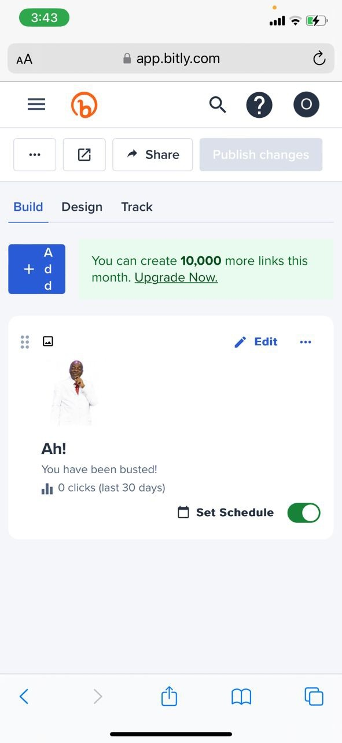
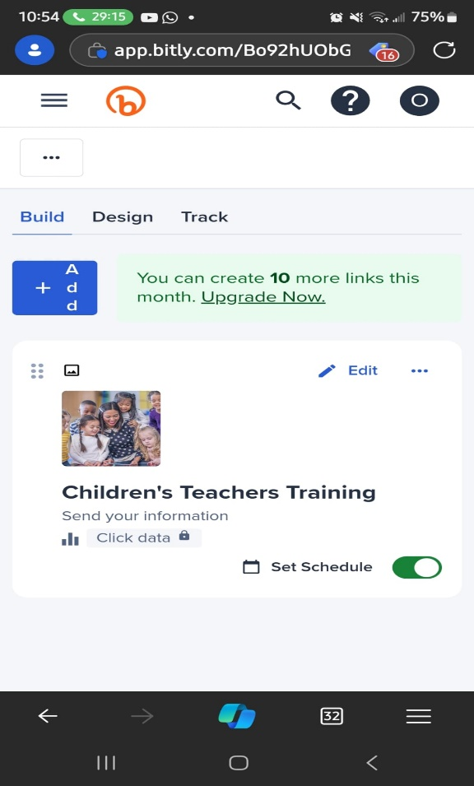
CREATING THE MALICIOUS LINKS
The first link was created with information to lure the participants into clicking the link.
The second link was then created after findings from the first link and social awareness training.
https://bit.ly/m/winnerschapelpapa70thbirthdaycelebrate The first link
https://bit.ly/m/Winnerschapelchildrensteachertraining The second link

Slide 5
AWARENESS TRAINING ON PHISHING
Tips
Be careful with your personal or confidential information.
What we call the zero-trust principle. This simply means you don’t trust any messages, emails, or calls until they are verified.
Verify the sender’s email address—most businesses will use their domain names (e.g., Faithtabernacle.org).
If you feel your information is compromised, quickly reset your password and alert your bank and other institutions.
Update your devices’ software regularly. You can put it on auto-update.
Use strong passwords and do not save your information on your phones. A password manager can help with storing your passwords.
Use two-factor authentication on your devices.
Following these tips can help avoid having leaked information.
Don’t be in a hurry to click any link, no matter how real it looks
An awareness training was conducted using the focus group created and most of the things below were shared to inform the participants on how to identify and avoid phishing scams.
Despite how common these attacks are, many people still fall victim to these scams because they are not patient enough to verify the information before acting or are not aware of ways to avoid it when received.

Slide 6
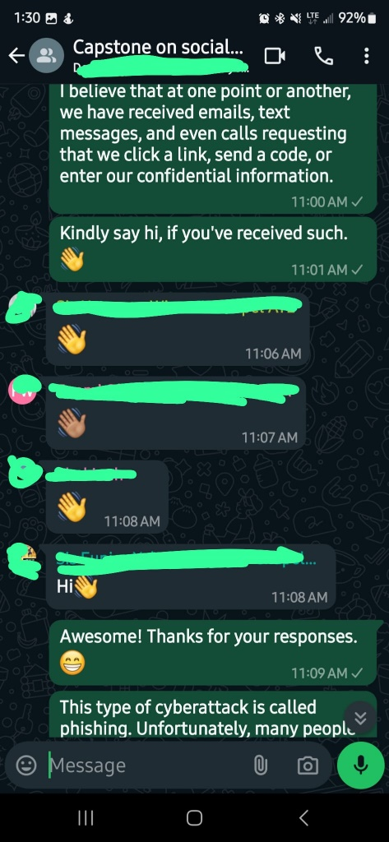
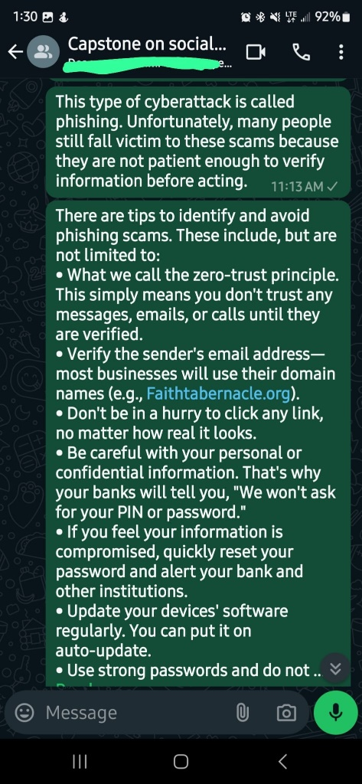
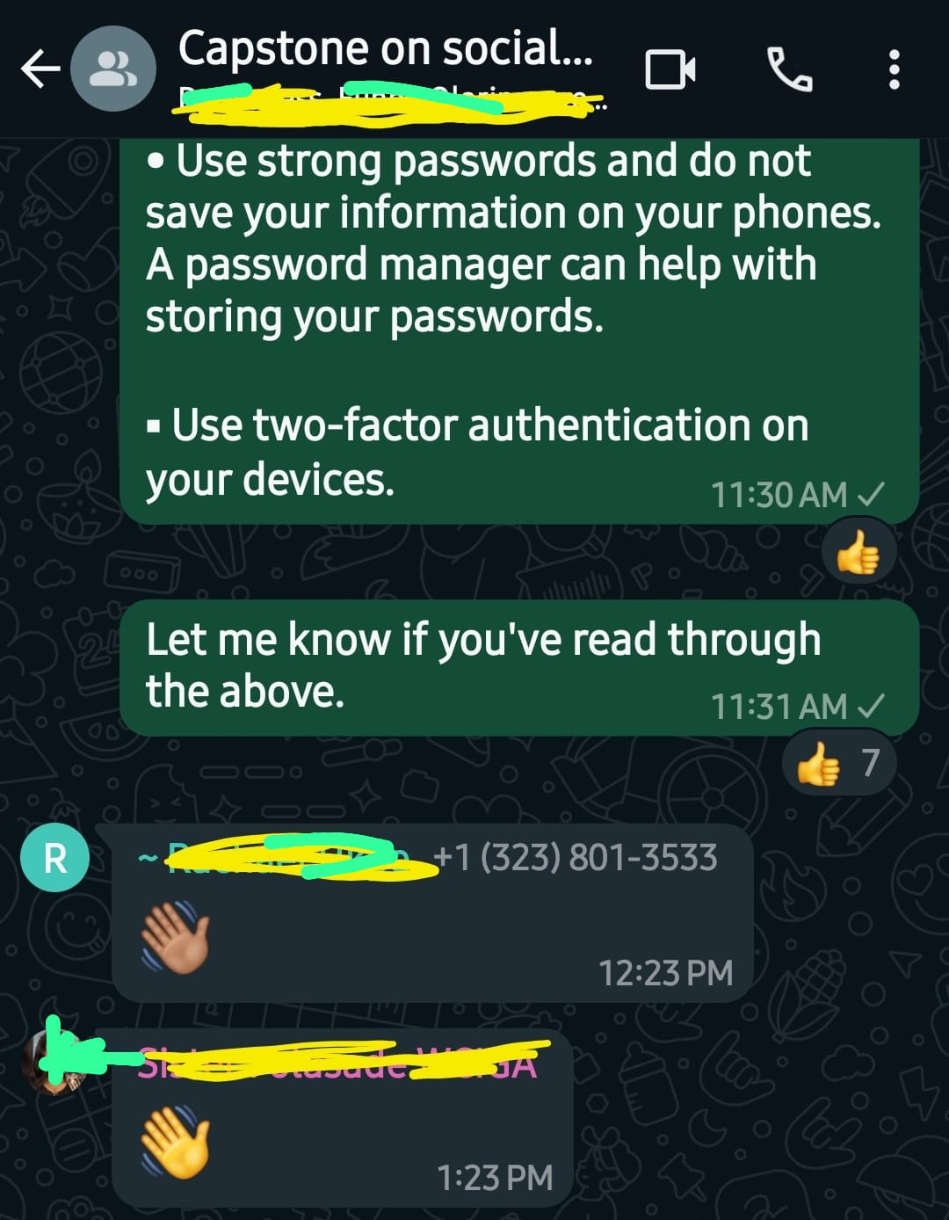
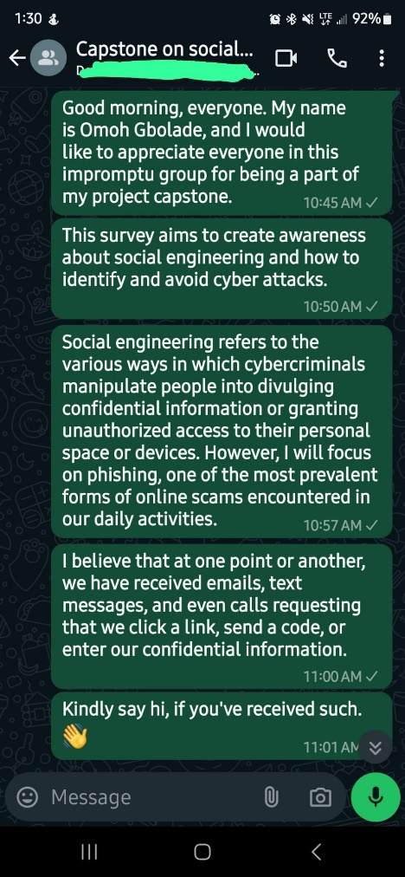

Slide 7
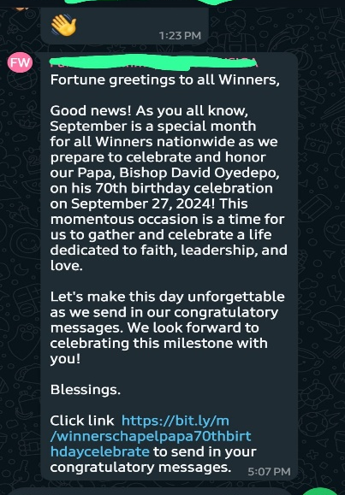
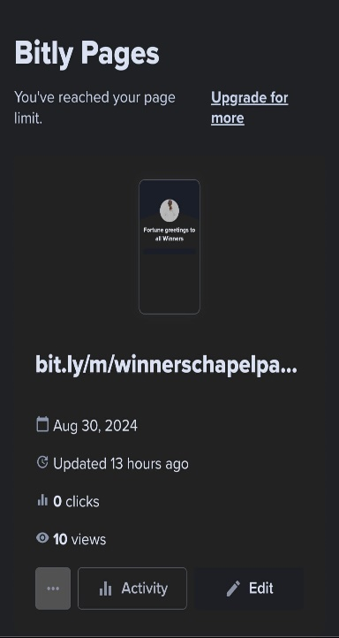
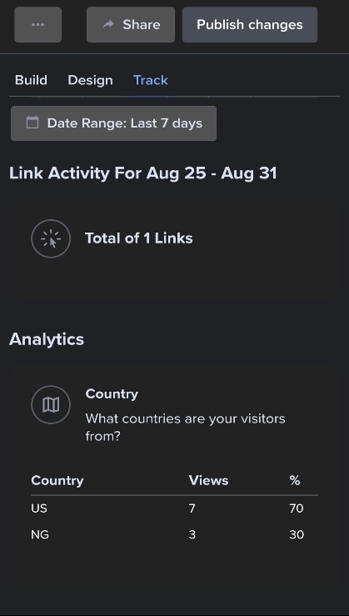
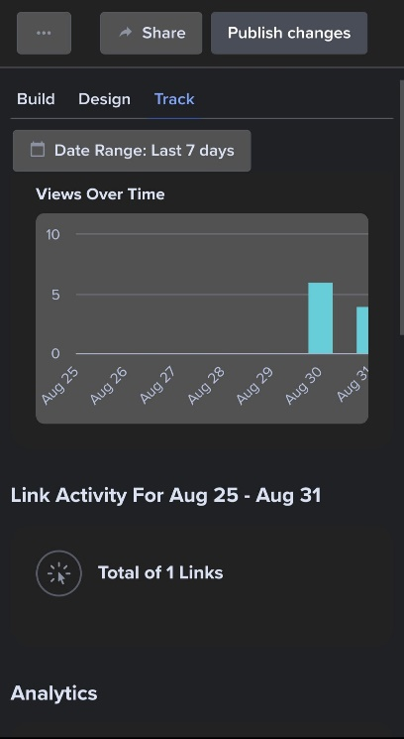
Findings
Out of a total of 19 active participants, seven members from the group still fell victim by clicking on the assumed malicious link.
Moreso, we had three people outside the group because the tracking showed another location which means, the message was forwarded outside the group.

Slide 8
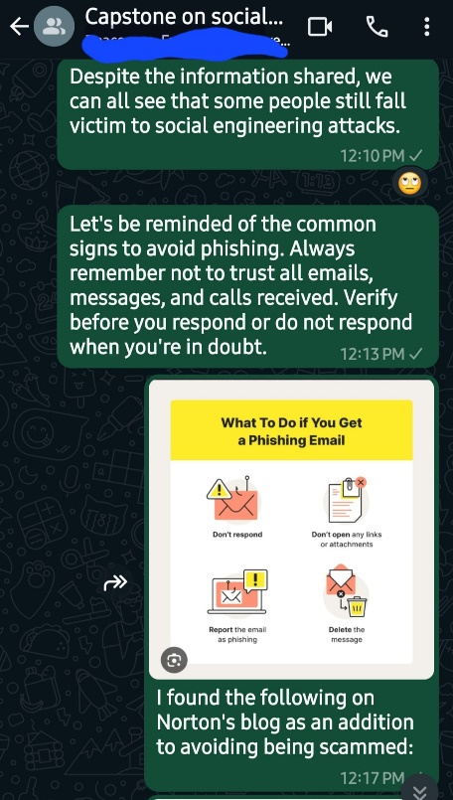
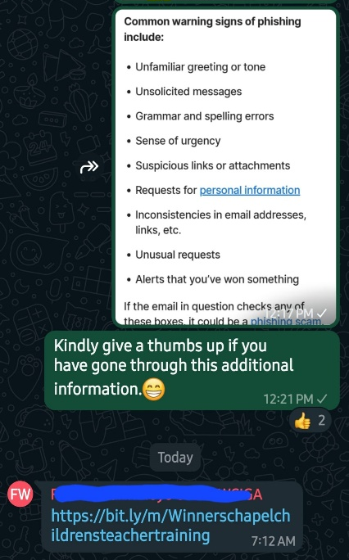

Evaluation
From our findings, the first awareness training had a low effective rate, as some participants still fell victim to the link.
This led to a second awareness training in which the results showed that a second training was a lot more effective than just one. As a result, no participant fell victim to the link.

Slide 9
CONCLUSION
Knowing fully well that these attackers always devise new ways to scam people, the best strategy to avoid or minimize social engineering attacks is for organizations to conduct regular awareness training and testing for their employees.

Slide 10
REFERENCE
Us.norton.com https://www.cisco.com/c/en/us/products/security/email-security/what-is-phishing.html
Cisco.com https://us.norton.com/blog/online-scams/what-is-phishing#:~:text=Ending%20the%20interaction%20after%20clicking,you%20clicked%20a%20phishing%20link

